Slide 1
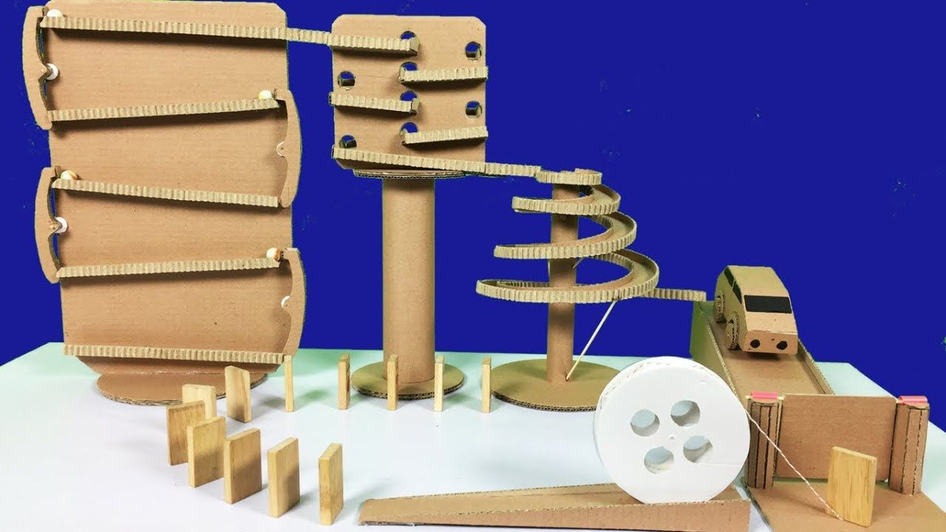
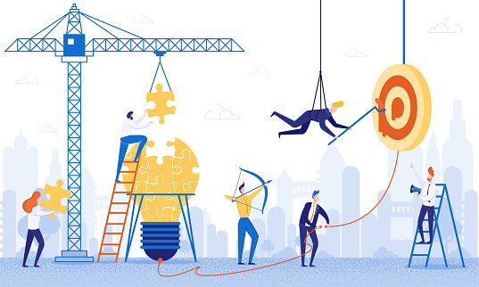
Lab-book
Norman
Team work

Slide 2
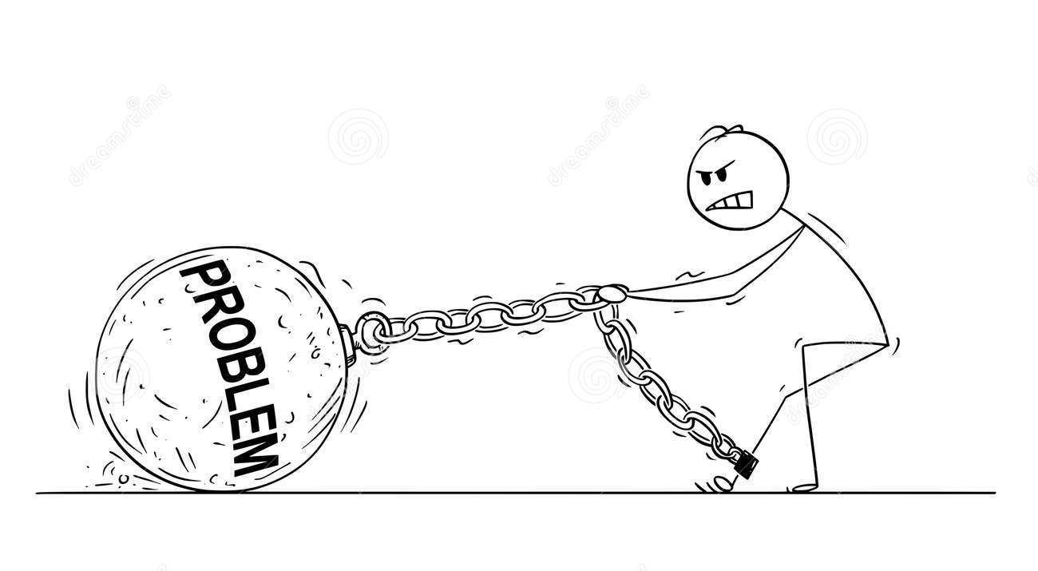
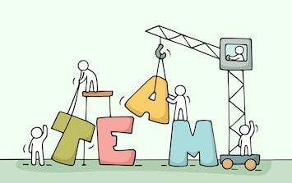
Problem
Team work is important to solve big problems, But some people are not that good at team work
Mission
We need to make a machine that can demostrates teamwork.

Slide 3
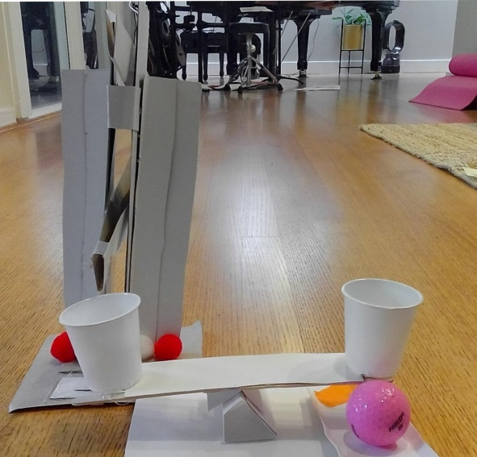
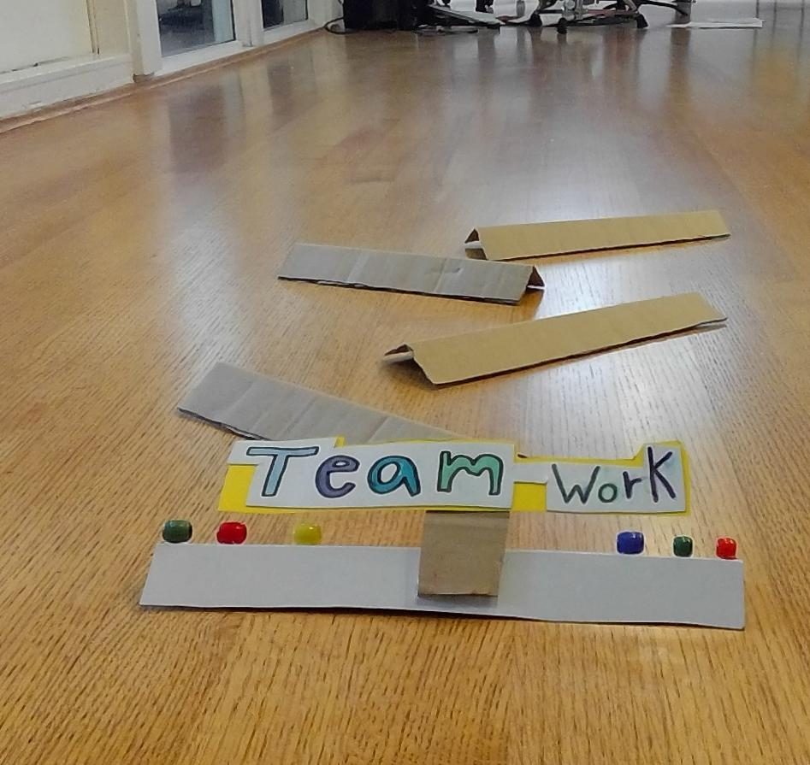
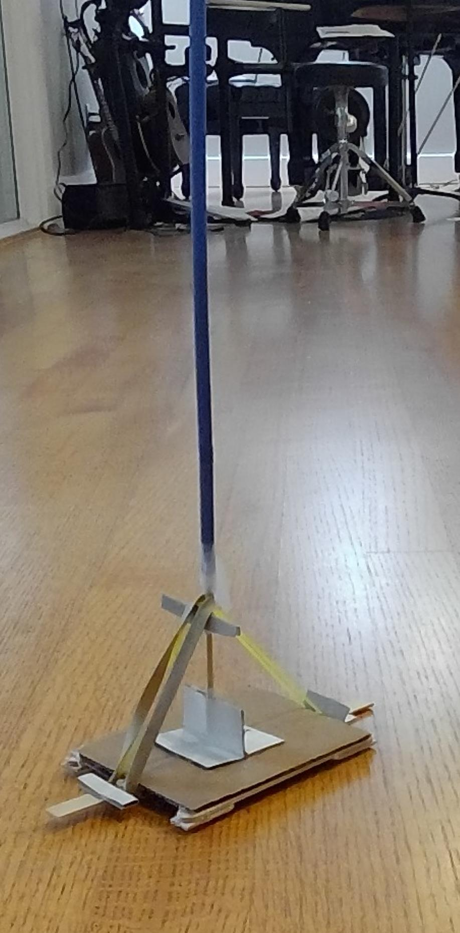
Coin spillway
Catapult
Bumper machine

Slide 4
Module: Bumper machine

Slide 5
Module: Catupult
Weight of projectile
Length of arm
Force
Angle of release

Slide 6

Module: coin spillway
Module: coin sensor
Module: ramp

Slide 7
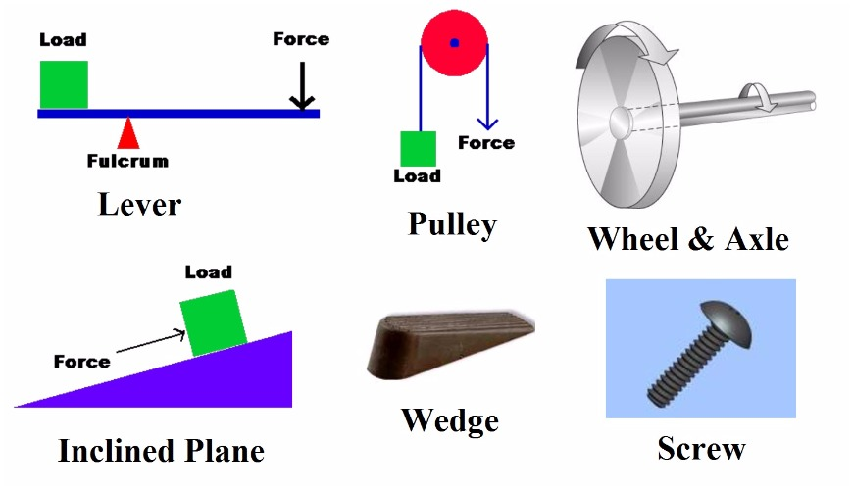
Simple machines

Slide 8
Graffiti

